Slide 1
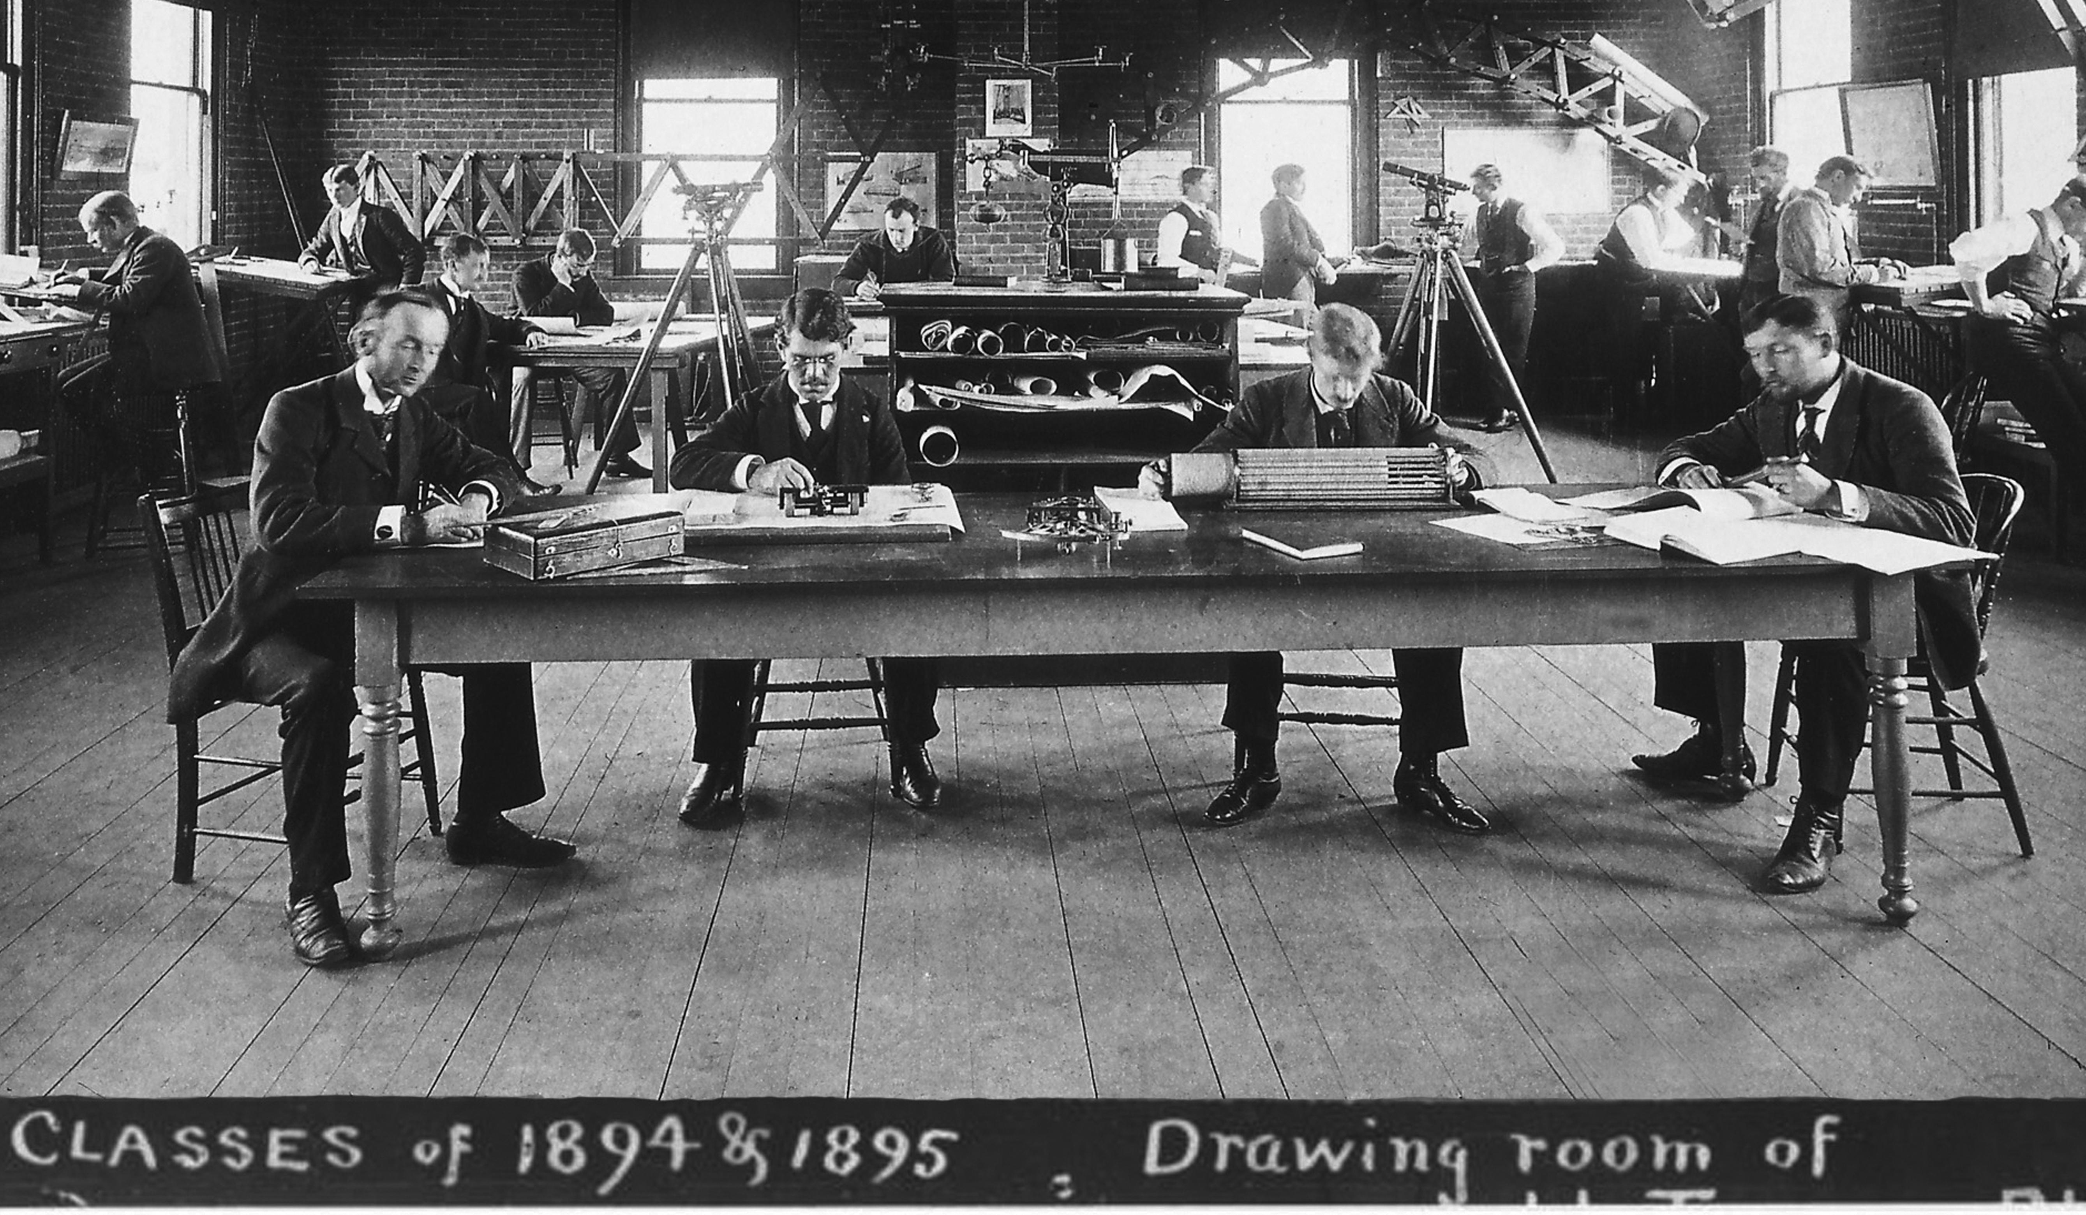
Computing before Electronics
Creating a Short Course on the History of Calculating Techniques.
Virtual IM 2020, September 12-13, 2020
Thayer School students at their computations with Prof. Robert Fletcher (left) in about 1894.
Thayer School of Engineering
Dartmouth College
Hanover, New Hampshire U.S.A.
H. J. Frost
(harold.j.frost@dartmouth.edu)

Slide 2
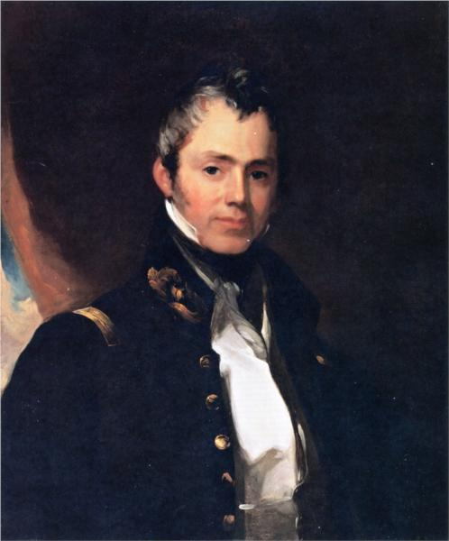
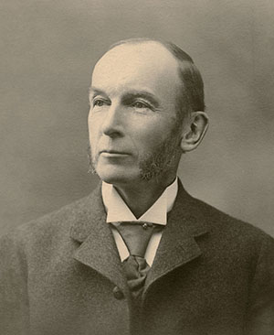
Sylvanus Thayer
Robert Fletcher
(1848 – 1936)
Graduate of West Point
First Dean of Thayer School
(1871 – 1918)
(1785 – 1872)
Valedictorian of Dartmouth College 1807
Superintendent of the Military Academy
at West Point (1817 – 1833).
Gave a bequest to found an engineering
school at Dartmouth in 1867.

Slide 3
Dartmouth Winter Interim
• The Dartmouth Fall term ends before Thanksgiving (since 2012), and Winter term starts after New Years Day.
• Most students are away throughout December, but some, particularly international students and graduate research students, remain on campus.
• To provide academic content for these students, the Thayer School offers a few short courses, each of about a week duration, during the first two weeks of December.
• Computing Before Electronics was first offered in 2018, and then repeated in 2019. We are uncertain about 2020.
• Prerequisite is multivariable calculus. This admits essentially all engineering and physical science majors, but also some others.

Slide 4
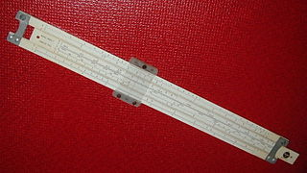
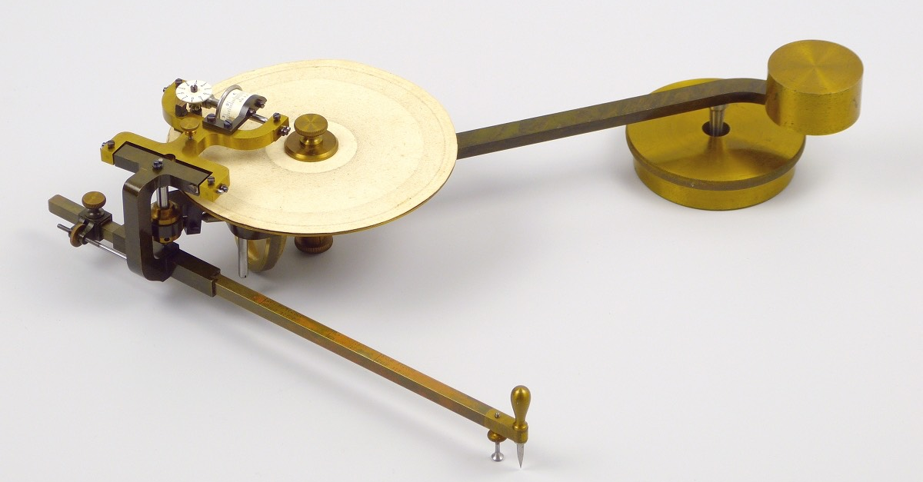
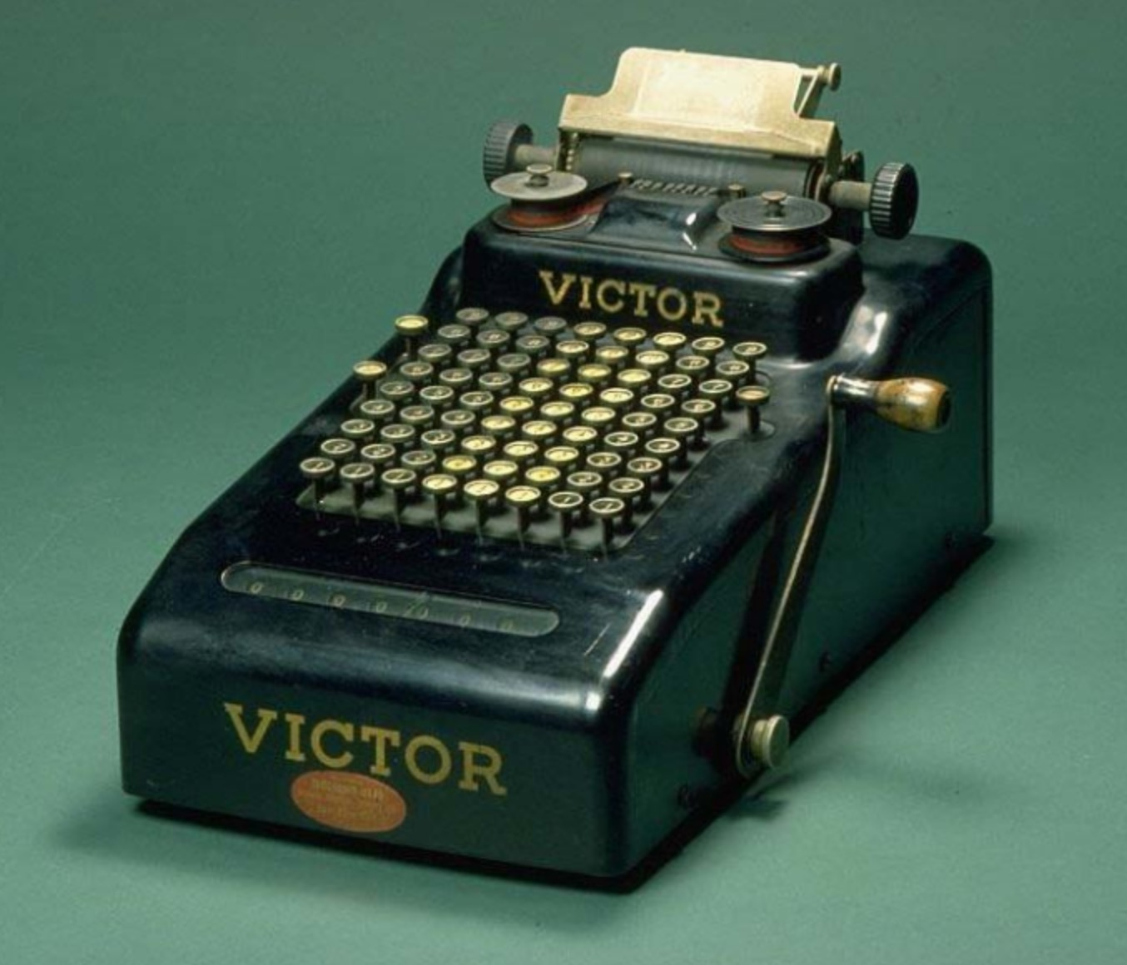
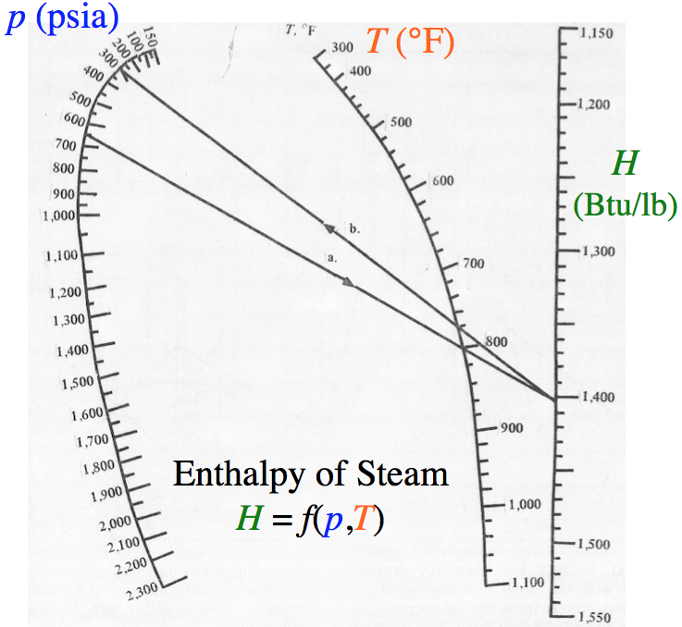
Four Days - Four Different Topics
• Slide Rules and other scale-comparison calculators.
Primarily used for multiplication/division.
• Planimeters and Integrators.
Mechanical devices for measuring area
and more complicated line integrals.
• Adding Machines and Digital Arithmetic.
Most adept at addition and subtraction, but able
to perform multiplication by repeated addition.
• Graphical Methods: Special Charts and Papers.
e.g. Nomograms: special charts constructed
specifically to solve particular equations.
Notes:
Screen Victor adding at Smithsonian.jpg

Slide 5
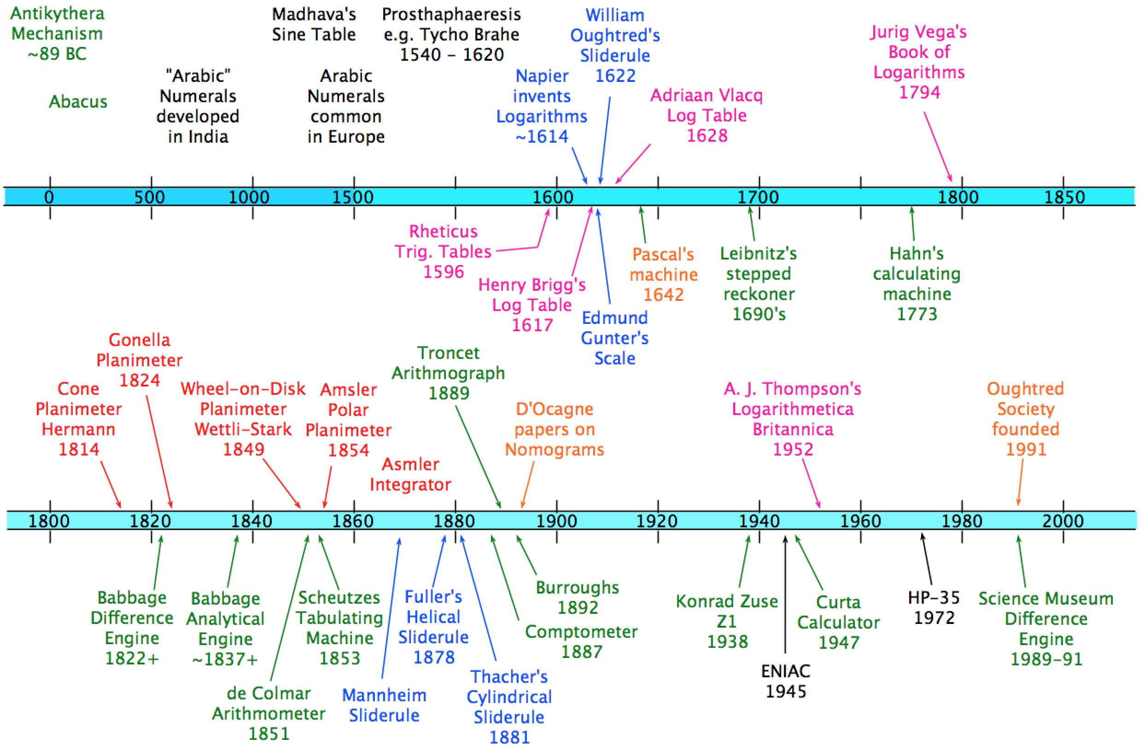
Historical Perspective is Important
Calculations were crucial to engineering and commerce long before convenient electronic calculations were possible.
Timeline Figure
Notes:
Screen Intro timeline as of 8-20-20.png

Slide 6
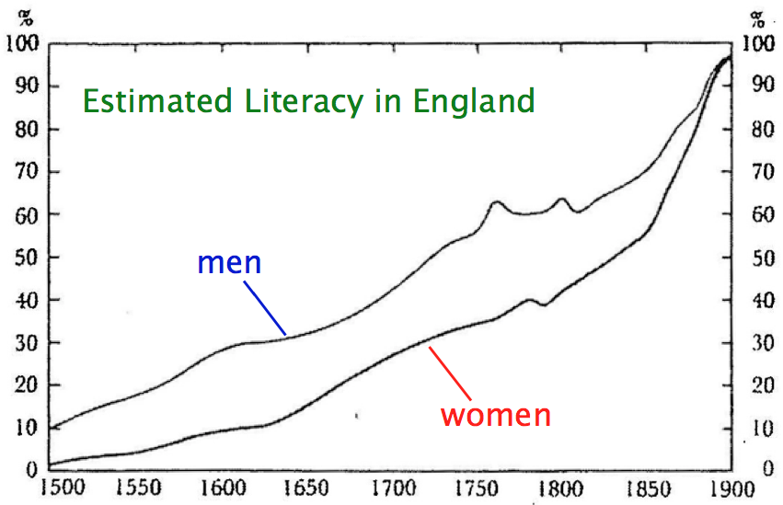
Numeracy Probably Tracked Literacy.
Shakespeare
Newton
Dickens
(Literacy in England was generally the highest of the major European powers.)
David Mitch, Education and Skill of British Labour Force, in Floud & Johnson, eds.,
The Cambridge Economic History of Modern Britain, Vol. I: Industrialisation, 1700-1860.
Notes:
Shakespeare 1564 – 1616; Dickens 1812 – 1870; Newton 1643 – 1727; Screen Literacy in England.png; from Literacy figure in MacDraft.md60

Slide 7

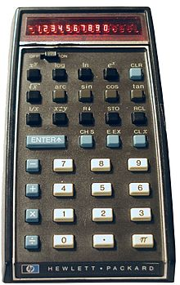
End of the Pre-electronic Age
The beginning of electronic calculation.
ENIAC
Electronic Numerical Integrator and Computer
The first electronic general-purpose computer.
Completed in 1945 at the University of Pennsylvania.
Hewlett-Packard introduced the HP-35 log/trig handheld calculator in 1972 for $400.
(The beginning of the End.)
(Pretty much the End.)
(Wikipedia, 2020, ENIAC, U.S. Army photo)
Notes:
628px-Eniac.jpg; 220px-Hp-35.jpg (probably)

Slide 8
Factors for Judging Computing Techniques
Calculations inevitably present a trade-off among various factors.
• Accuracy.
• Precision.
• Effort (Labor) of the Computation.
• Cost of the required Equipment (Capital Investment).
The trade-off between initial costs (mostly for the equipment) and operating costs (mostly labor) is a commonplace issue.
The factors of Accuracy and Precision require more comment.

Slide 9
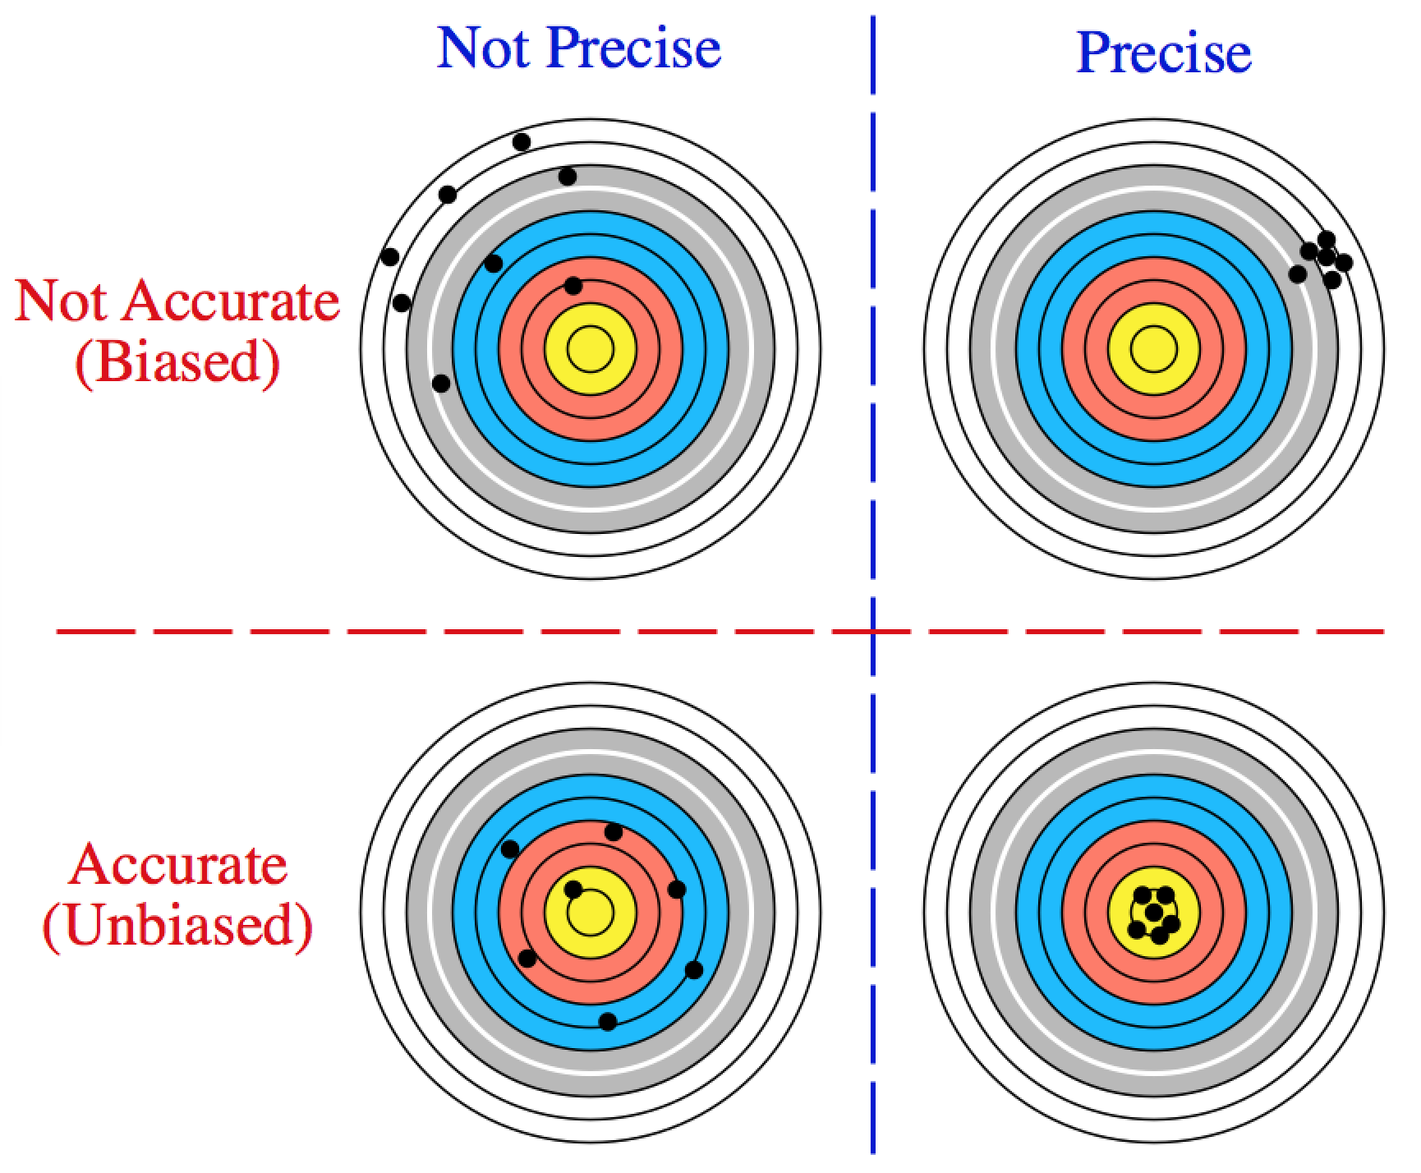
Precision versus Accuracy (Lack of Bias)
Accuracy is the degree of closeness to the "true" value of a measured quantity.
Precision is the degree to which repeated measurements yield the same value.
New ASTM standard E177-10 (November 2010), replaced “accuracy” and “accurate”
with “bias” and “unbiased”.
The definition of accuracy implies the "true" value can be known.
Without knowing the "true value" the distinction is difficult to apply.
In ordinary calculations, "Precision" and "Accuracy" get mixed up and lumped together as "Accuracy" or ”Number of Significant Figures” or
“Number of Significant Digits”.
Notes:
Screen precise-accurate 2020.png; from Precise-Accurate/Unbiased 2020.md60

Slide 10
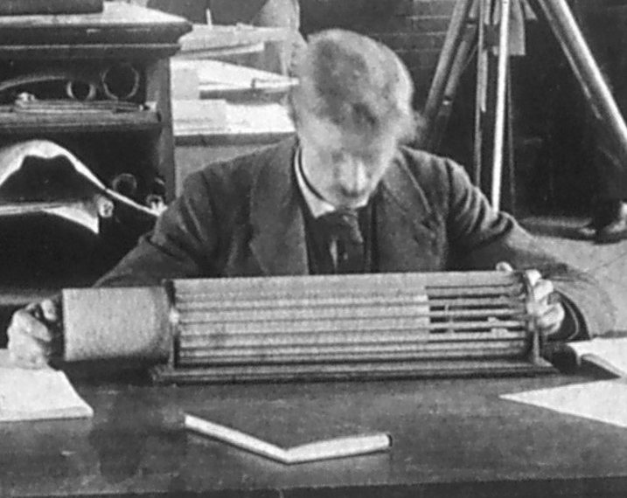
Day 1: The Logarithmic Scale and The Slide Rule.
Thayer School's example of Thacher’s Calculating Instrument.
(Photograph from Dartmouth College Archives)

Slide 11
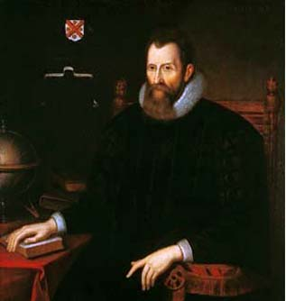
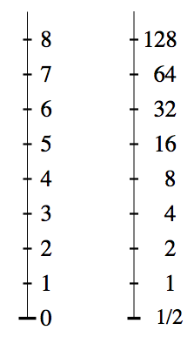
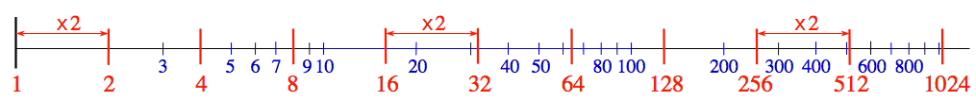
Introduction to The Logarithmic Scale
Logarithm :
One of a particular class of arithmetical functions,
invented by John Napier of Merchiston... (O.E.D.)
from the Greek:
λόγ-ος word, proportion, ratio
+ ἀριθμός number
John Napier. 8th Laird of Merchistoun
(1550 - 1617)
Scottish Mathematician,
The Discoverer of the Logarithm
(Mirifici Logarithmorum
Canonis Descriptio, 1614)
(portrait from Wikipedia, 2011)
Notes:
Screen linear and multiple scales B;
John_Napier.jpg

Slide 12
Using Logarithms
Students have seen logarithms, but often have never used them.
A review is appropriate.
Given y and z, to compute:
• Look up the logarithm of y:
• Look up the logarithm of z:
• Compute:
• Look up the anti-logarithm of log₁₀(w):
Multiplication (and division) were performed by reference to a table (often filling an entire book) giving values of N and log₁₀(N).
I show some examples of log tables, including my own CRC Handbook.

Slide 13
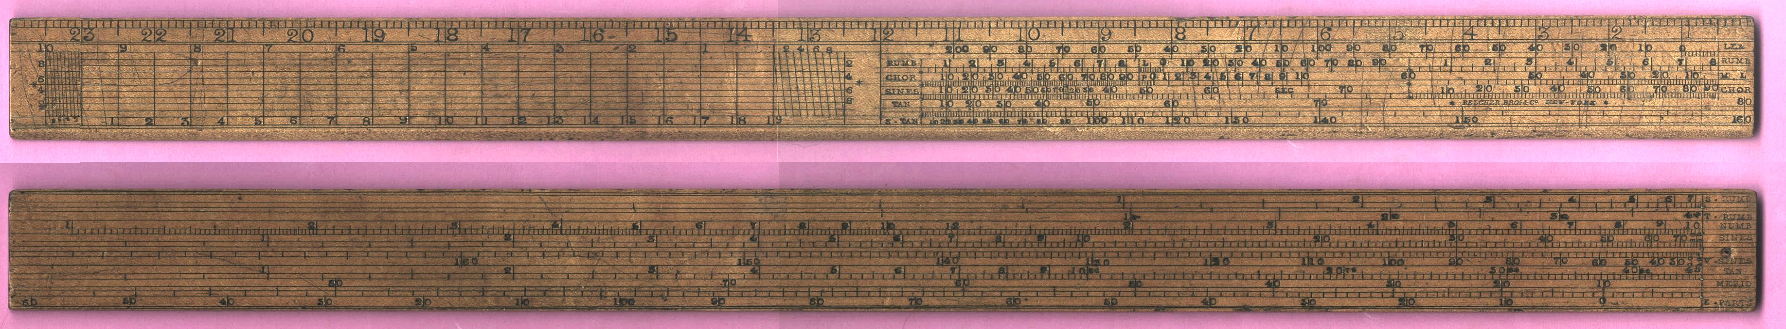
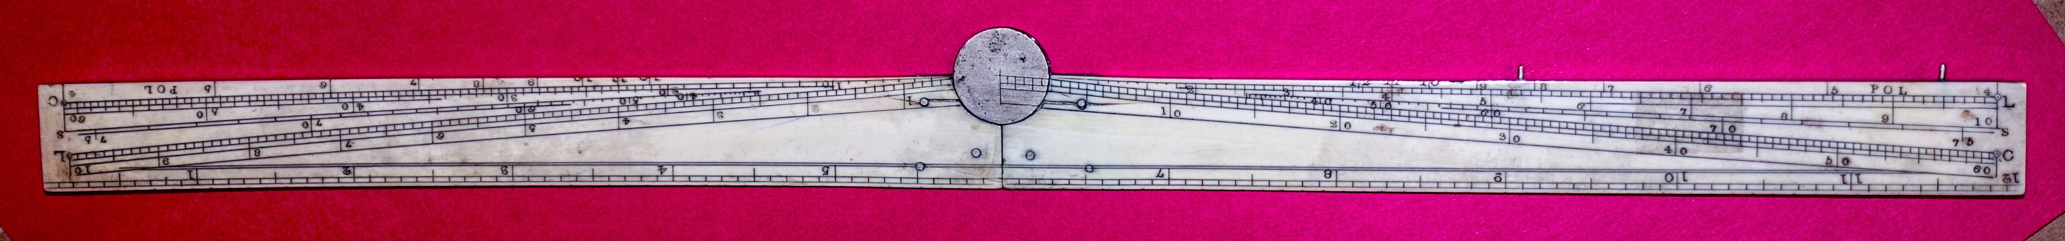
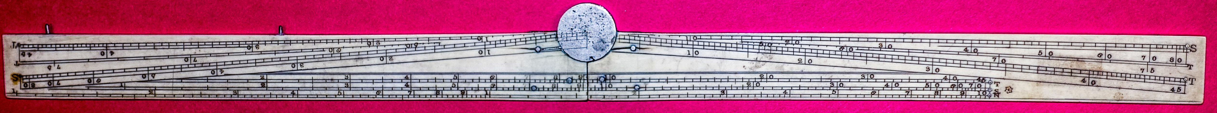
Single Scale Instruments
Gunter’s Scale
Log Scale (two decades), labeled "NUMB”, called "the number line"
Photograph from sliderulemuseum.com/Rarities/Gunters_Scale_Belcher_Bros_NewYork.jpg
Sector (fully opened)
Linear Scale
Reverse
Obverse
Sines
1st Decade
2nd Decade
Photo courtesy of Doug Fraser, 2017
Thayer School
Logarithmic Scale (N)
Sine (log scale) (S)
Tangent (log scale) (T)
Notes:
Sector obverse 442 KB.jpg; Sector reverse 400 KB.jpg; both exported from larger photo files. DAF-20170908--04194 sector obverse.jpg, DAF-20170908--04195 sector reverse.jpg

Slide 14
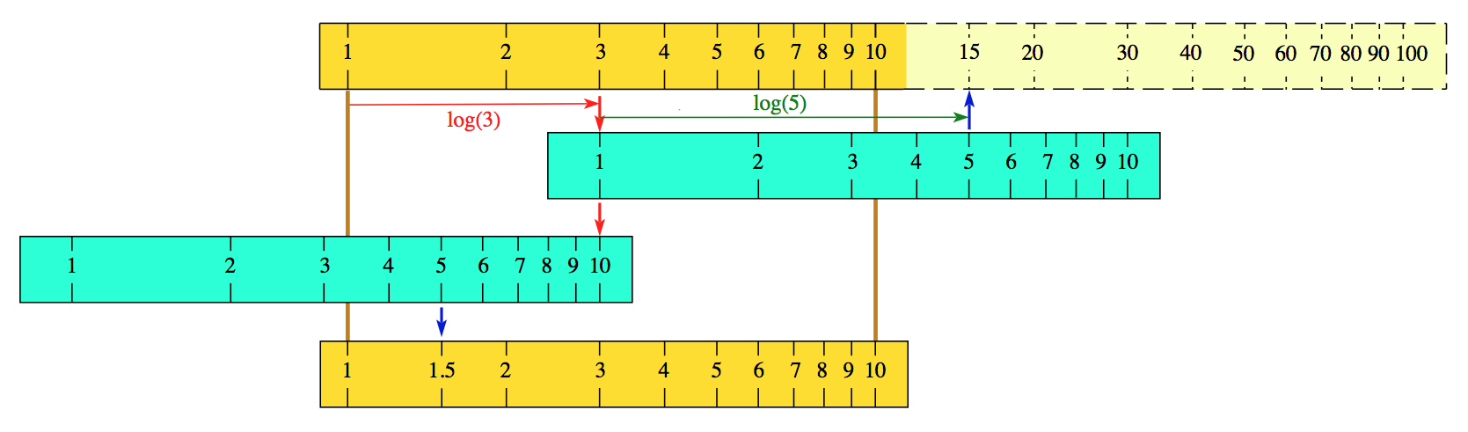
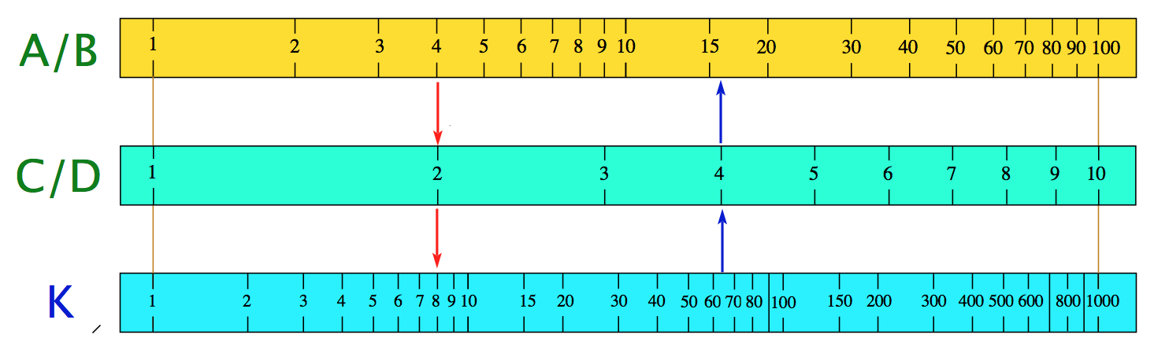
Basic slide rule operations must be taught from scratch.
The user must keep track of where the decimal point belongs.

Slide 15
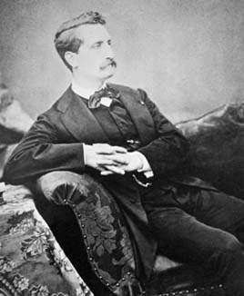
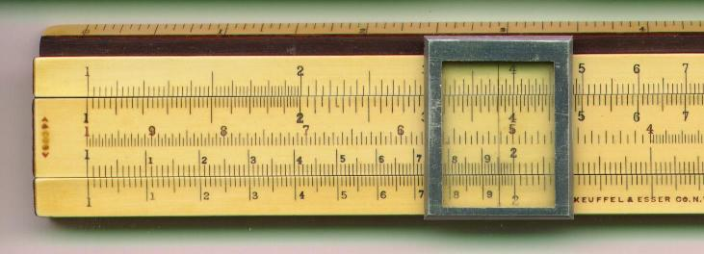
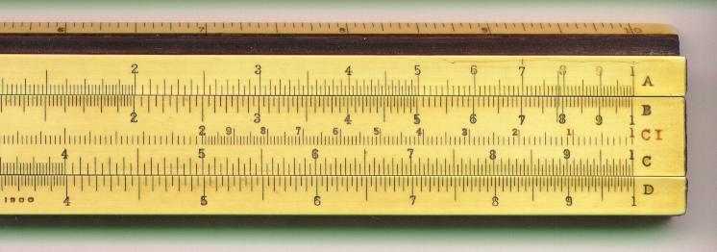
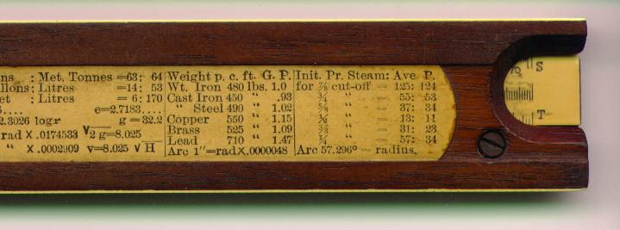
Victor Mayer Amédée Mannheim
The standard model was introduced by Mannheim in 1860s.
A/B scales have two decades.
A
B
C I
C
D
C/D scales have one decade.
C I scale is “inverted”.
S
L
T
(1831 – 1906)
French Army Officer and Mathematician
Developer of the Modern Slide Rule
Keuffel & Esser model 4053
Photos from Clark McCoy
Notes:
Amedee_Mannheim.jpg; ke4053_1a.jpg; ke4053_1b.jpg; ke4053_1e.jpg

Slide 16
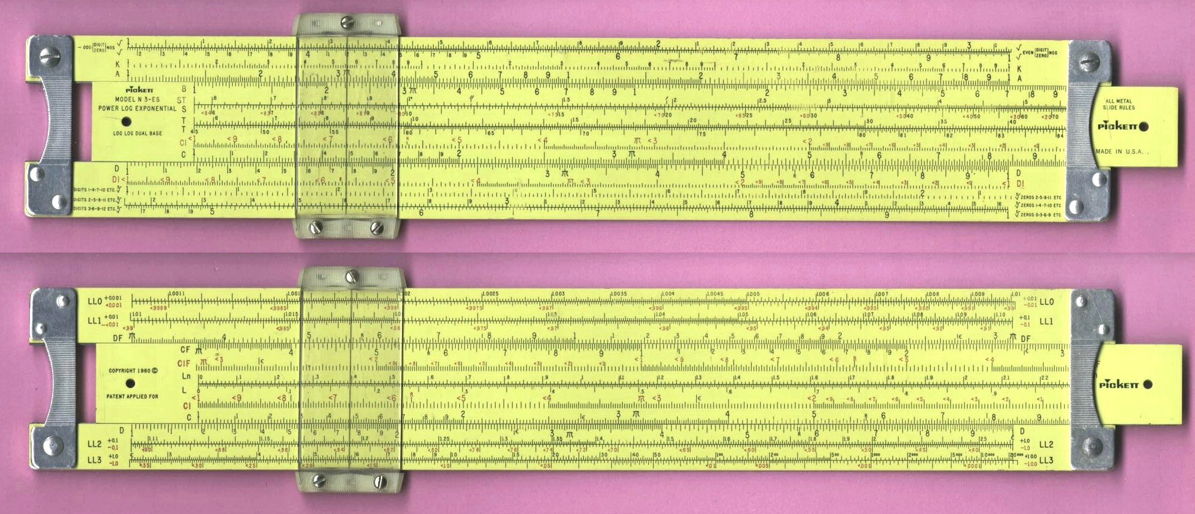
Pickett Model N-3-ES
Finding the Basic Scales
Power Log Exponential
(Made in U.S.A., 10 inch, copyright 1960)
Popular model for engineering students in the 1960's.
Secondary Scales with two decades (squared): A and B
Scale with three decades: K
Front
Back
Primary calculating scales, C and D
Primary scales "folded", CF and DF
(runs from π to 10 × π)
The many other scales show trig. functions. etc.
(image from the International Slide Rule Museum
http://sliderulemuseum.com)
Notes:
Pickett_N3-ES_PowerLogExponential_DonatedByJohnLCrawley.jpg; through Pickett_N3-ES_PowerLog low res.jpg

Slide 17
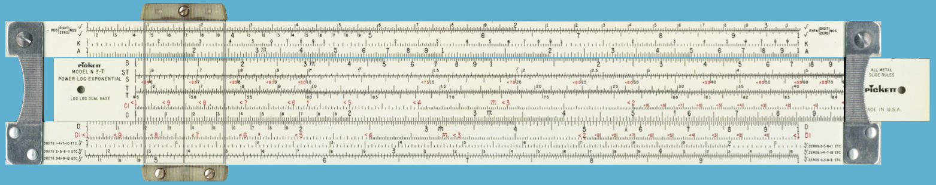
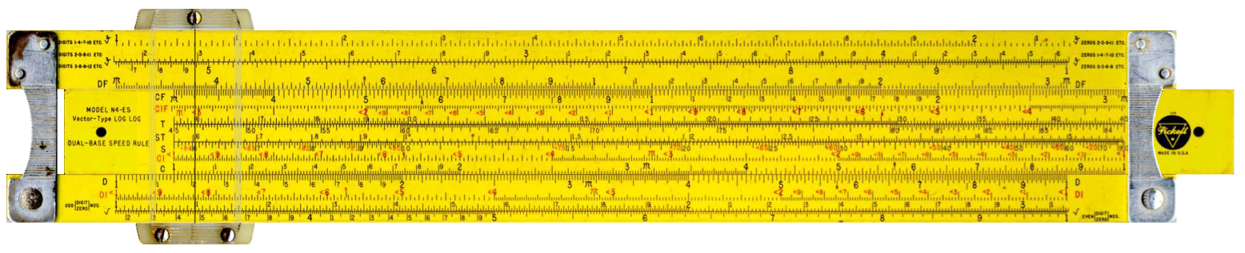
Hyperlink to Virtual Slide Rule
These sites work better for basic instruction than the old 6-foot classroom models.
http://www.antiquark.com/sliderule/sim/n3t/virtual-n3-t.html
http://www.antiquark.com/sliderule/sim/n4es/virtual-n4es.html

Slide 18
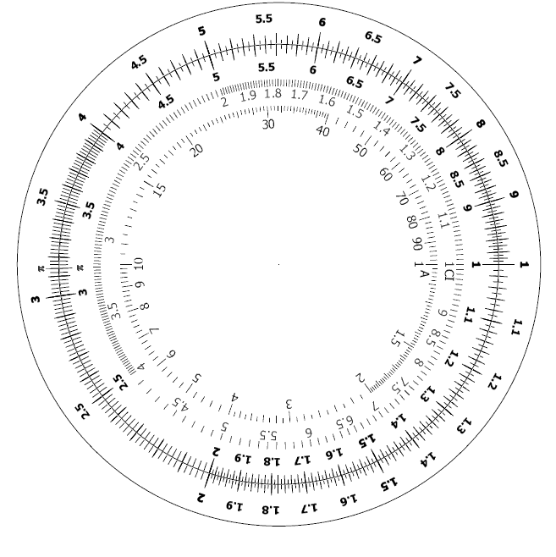
Students were given a used K&E log-log model and a circular sliderule kit.
Two images on card stock,
a clip for the center, and the use of scissors and a hole punch.
(from eBay seller p2pprocurement, 10/15/18)

Slide 19
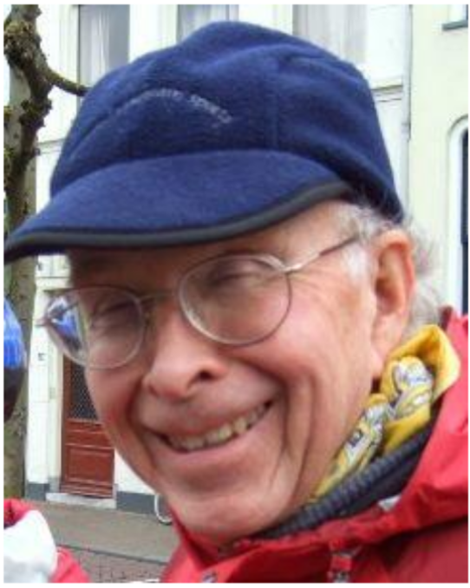
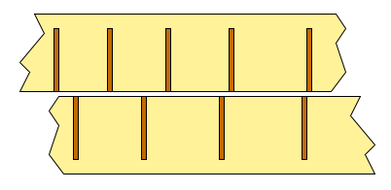
Slide Rule Accuracy
In general the accuracy improves as the scale gets longer.
Markings are usually engraved down to the smallest size that is comfortable for ordinary vision to distinguish.
The longer the scale, the finer the division
of the range of numbers that can be
represented by the marks.
The limit of precision is about 1/10th
of the spacing between marks.
Edwin J. Chamberlain
Hanover Center Civil Engineer
(1938 – 2017)
(Oughtred Society Newsletter, 10/2015)
Unusual slide rules were created as means to lengthen the scales.
See papers by Edwin J. Chamberlain, "Long Scale Slide Rules",
Journal of the Oughtred Society, vol. 8, no. 1, pp. 22-34, 1999;
"Long Scale Slide Rules Revisited", J. Oughtred Soc. 13(1), 23-43, 2004
Notes:
Screen two scales with marks. from two scales with marks. (2-5-14); Ed Chamberlain from Oughtred newsletter 9/2015

Slide 20
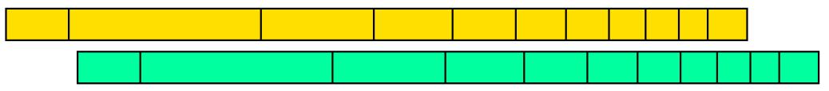
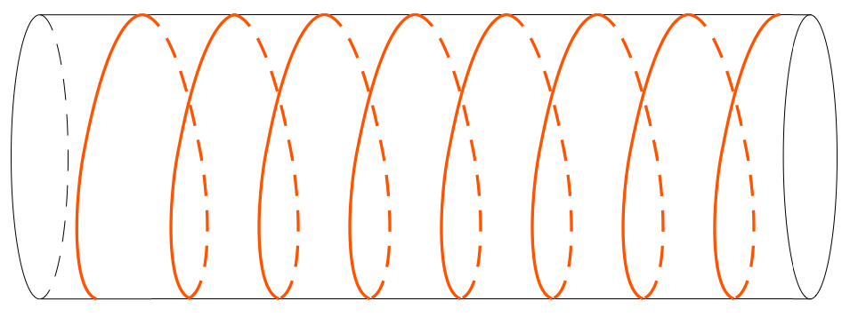
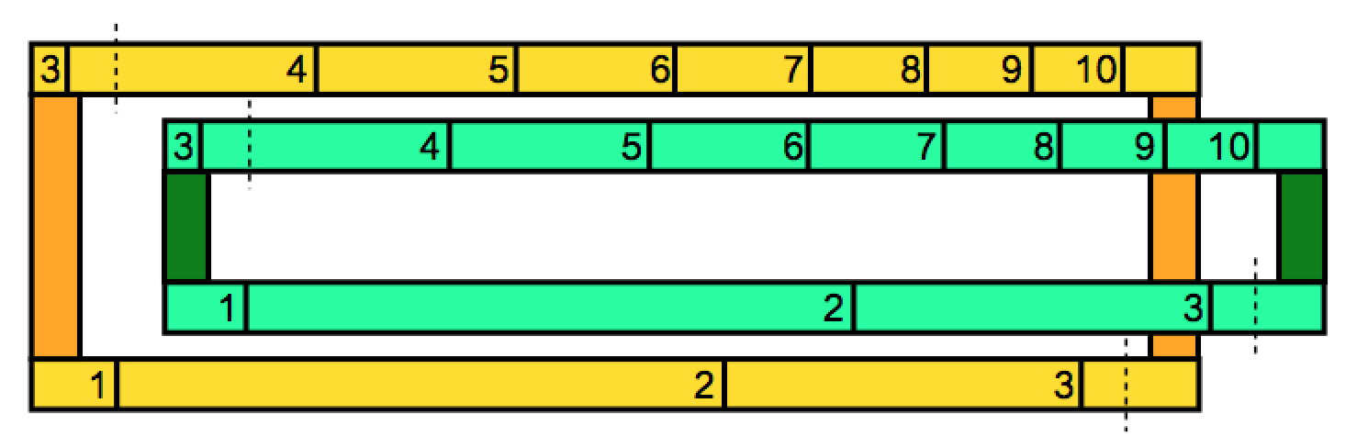
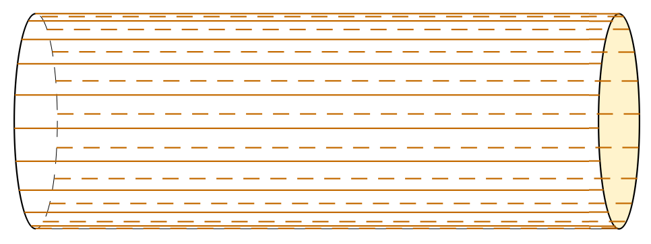
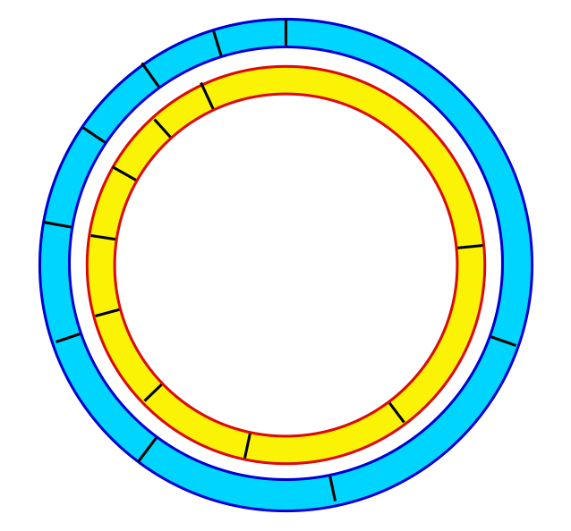

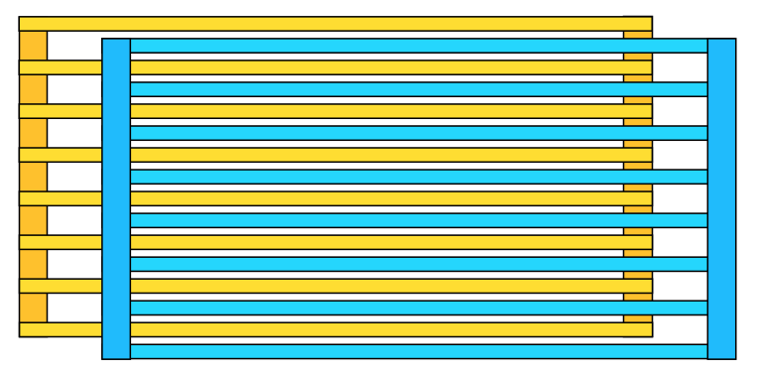
Alternative Slide Rule Geometries
A. Linear: Keuffel & Esser, Pickett
E. Helical: Fuller, Otis King
B. Segmented: Faber–Castell; Hemmi
F. Cylindrical: Thacher
G. Gridiron/Segmented Linear: Hannyngton
C. Circular:
Fearns, Fowler
D. Spiral:
Atlas Calculator
Notes:
Screen linear scale; Screen Circular Scales; Screen spiral; Screen Helix; Screen Cylindrical Scales; Screen segmented-linear scales.
all from: Alternate Geometries for scales.

Slide 21
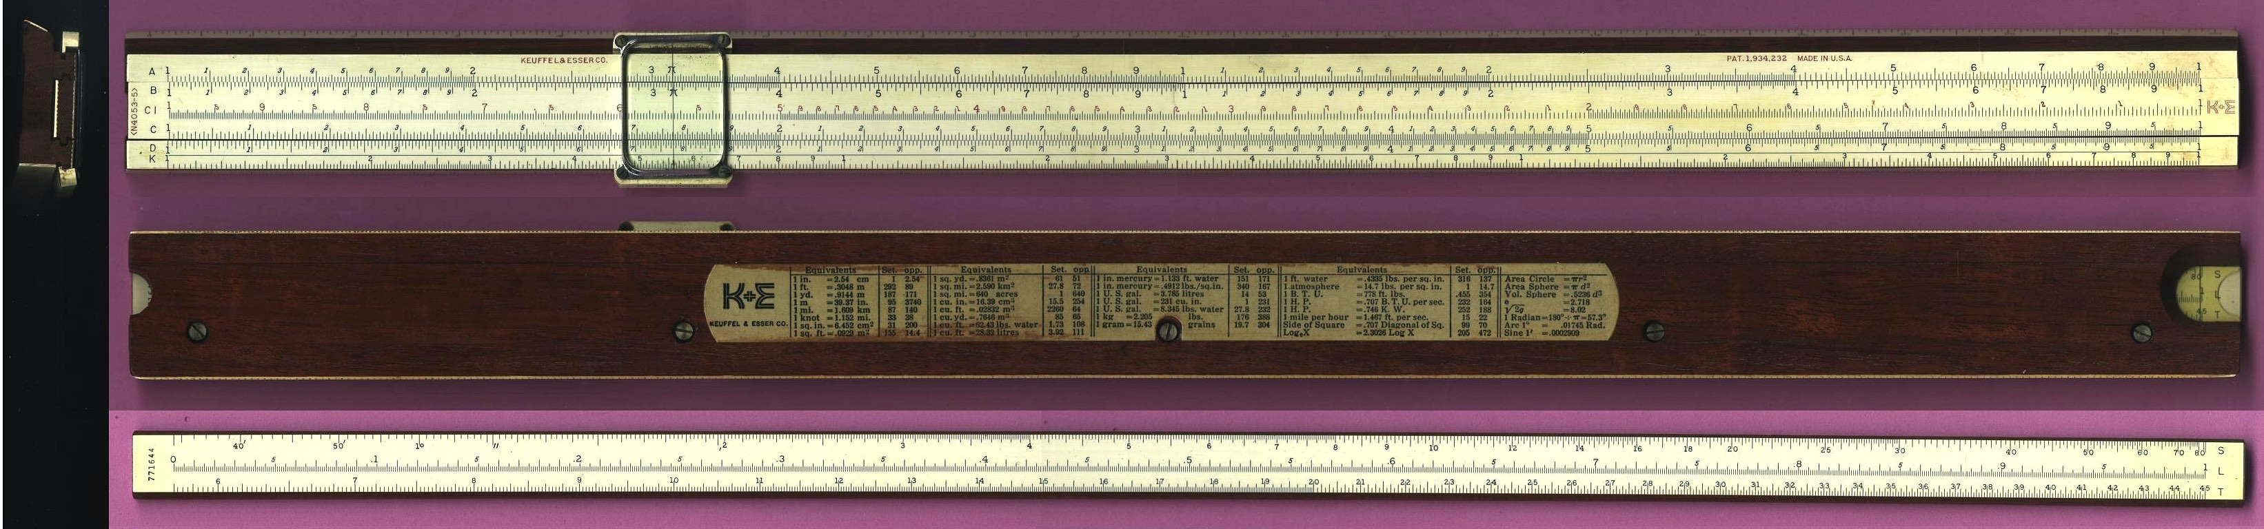
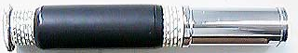
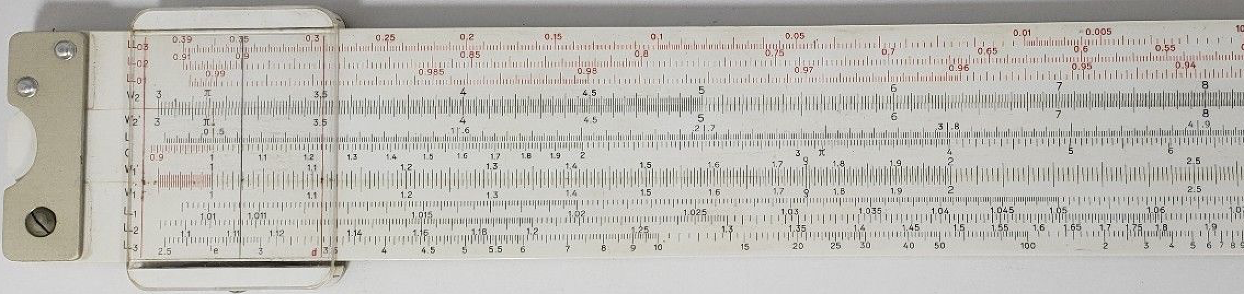
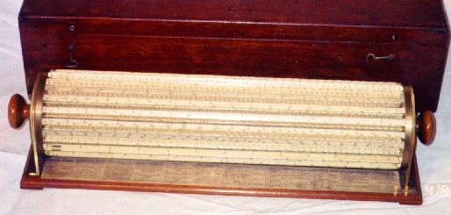
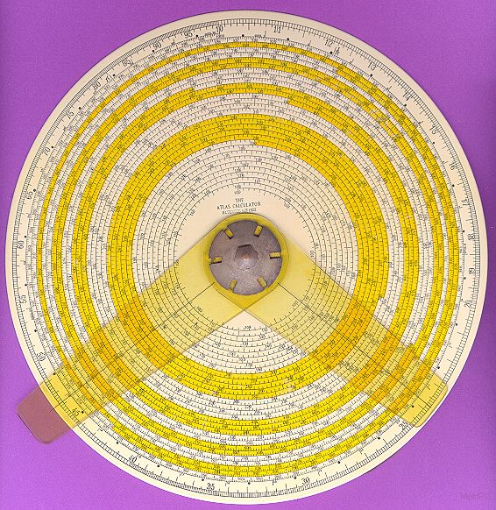
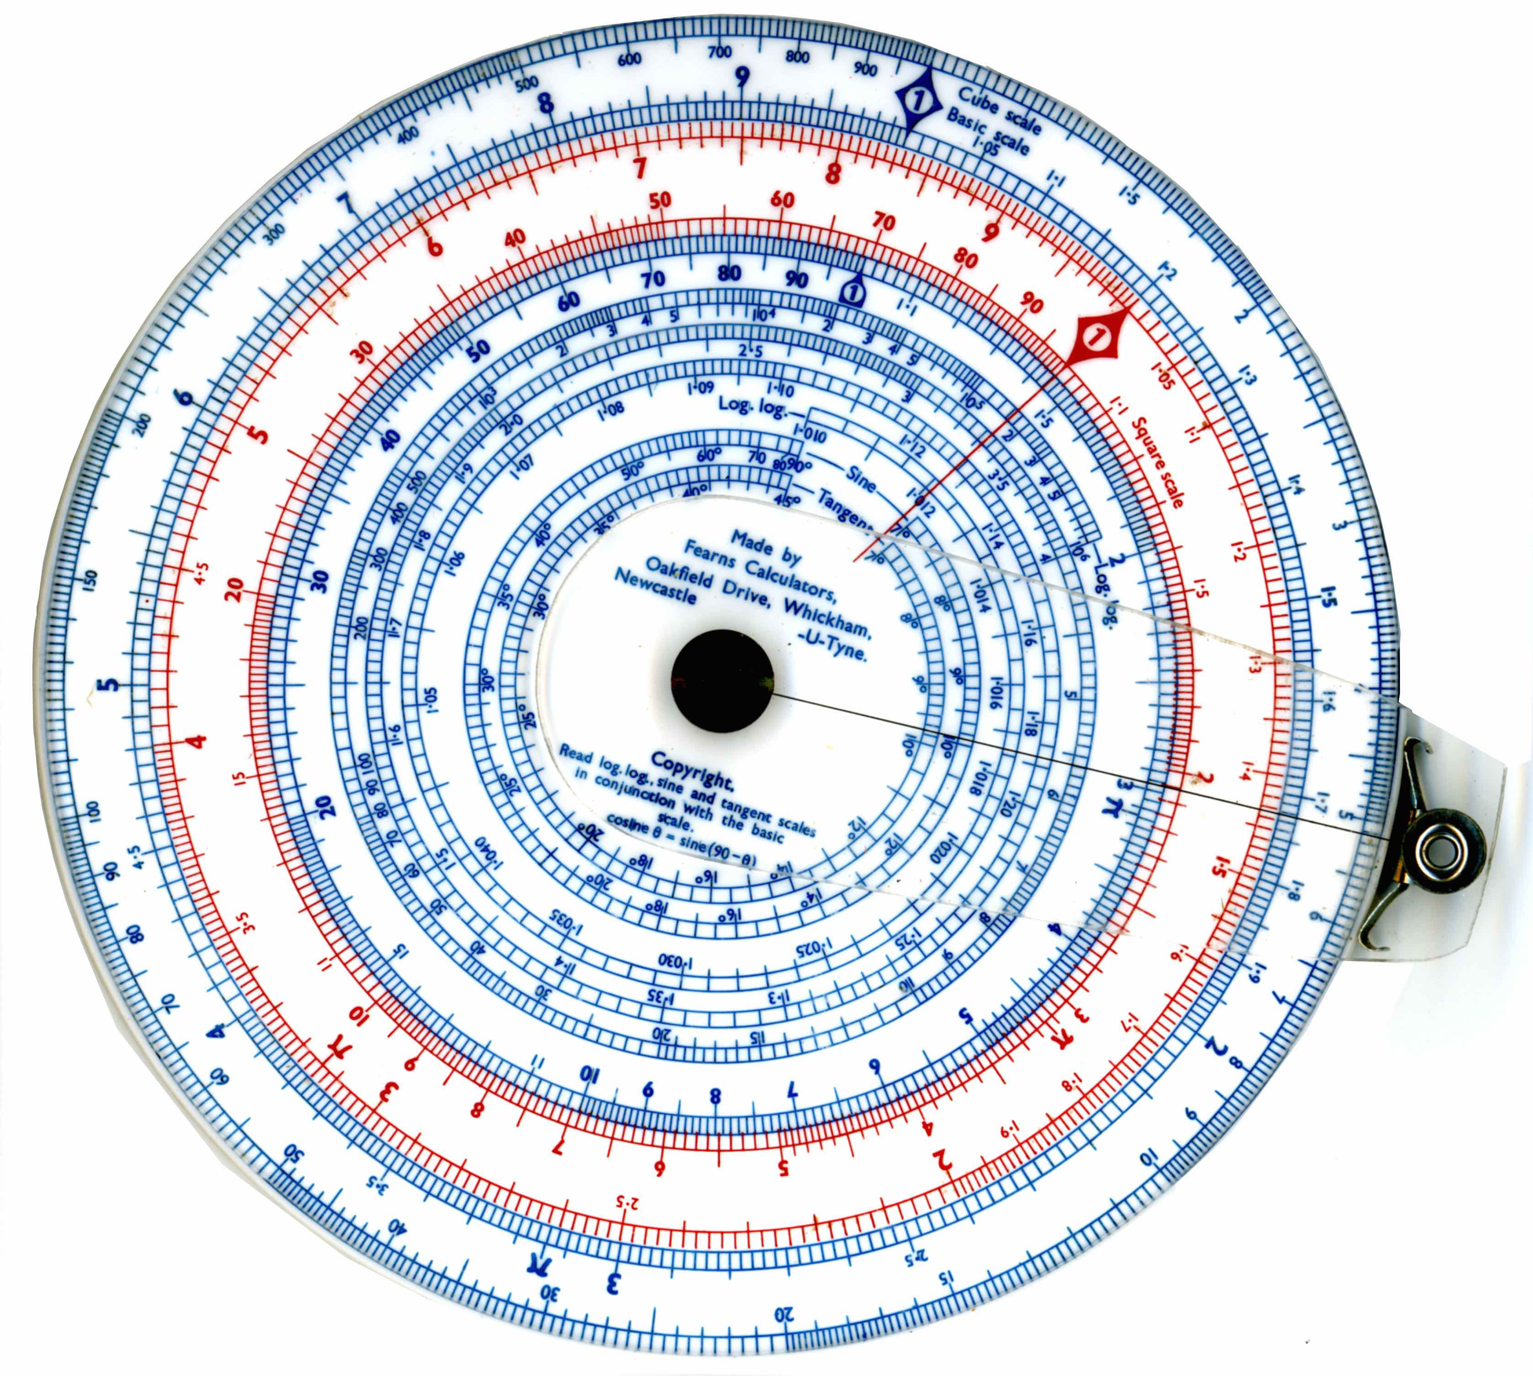
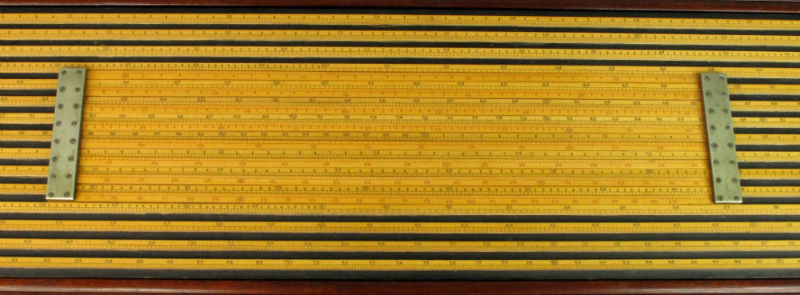
Examples of Alternative Slide Rule Geometries
A. Linear: Keuffel & Esser, Pickett
E. Helical: Fuller, Otis King
B. Segmented: Faber–Castell; Hemmi
F. Cylindrical: Thacher
C. Circular:
Fearns, Fowler
D. Spiral:
Atlas Calculator
G. Gridiron/Segmented Linear: Hannyngton

Slide 22
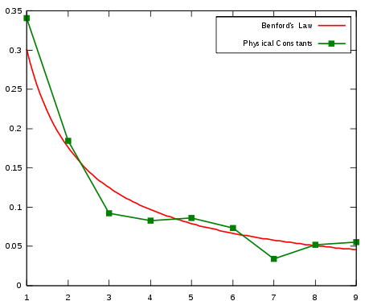
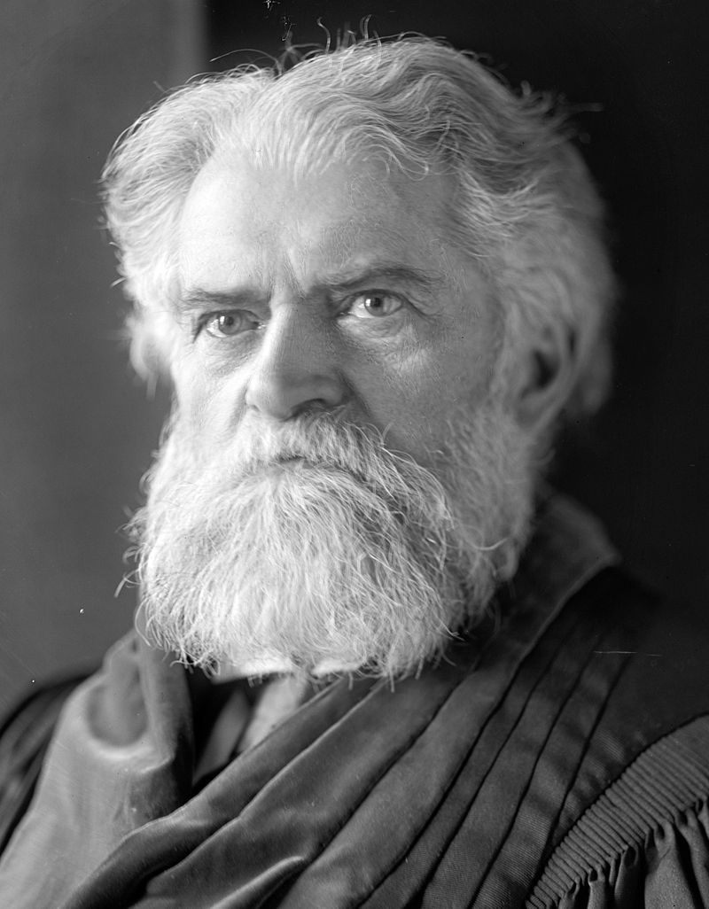
A Lesson of the Logarithmic Scale: Benford's Law*
“It’s a good bet (>1:9) that the first digit of a large number is 1.”
For many sets of numbers, the nine choices for first digit are not equally likely.
Many categories spread out more evenly on a logarithmic scale than on a linear scale.
Wikipedia, 2015
author: drnathanfurious
Frequency of first digit
Simon Newcomb
(1835 – 1909)
Canadian–American Astronomer and Mathematician
First Proposed Benford's Law (1881)
data on physical constants
from: http://physics.nist.gov/cuu/Constants/index.html
First Digit
*named after American engineer Frank Benford (1883 – 1948)
an example of Stigler’s Law of Eponymy:
“No scientific law is named after its original discoverer.”
(First proposed by sociologist Robert K. Merton.)

Slide 23
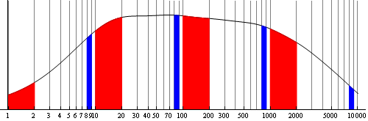
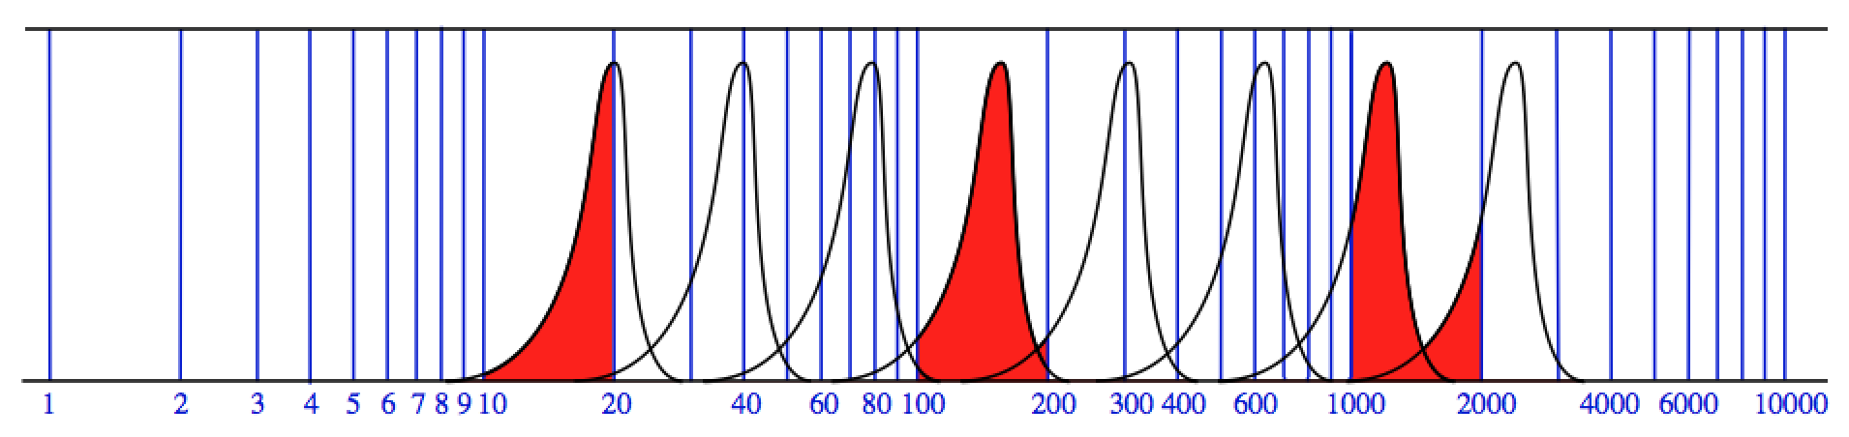
Distributions on a Logarithmic Scale
8xxx
1xxx
Frequency
Broad
Magnitude of Variable
Frequency
Narrow
Magnitude of Variable
(Top figure from Wikipedia, “Benford’s Law” (2016), author Jakob.scholbach)
Notes:
top: BenfordBroad.png; bottom: Screen log scale for Benford 2020.png; from log scale for Benford 2020.md60

Slide 24
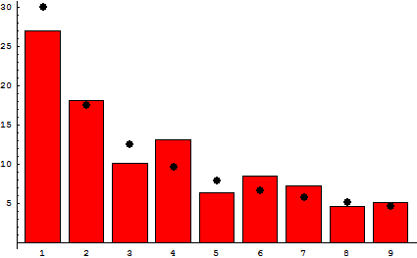
Populations of countries of the world
Data from CIA Worldbook, accessed 8-7-2010
Actual Populations
Number of Occurrences
Predictions from Benford's Law
First Digit
Figure from Wikipedia, “Benford’s Law” (2016), author Jakob.scholbach

Slide 25
Day 1 Conclusions
• Each student was given a (used) slide rule, typically a K&E log-log model found on ebay.
• Each student cut out a circular slide rule.
• Full Proficiency is difficult to achieve in a limited time.
• Students most appreciated getting to actually use the more complicated models. (Thacher, Fuller, Otis, etc.)

Slide 26
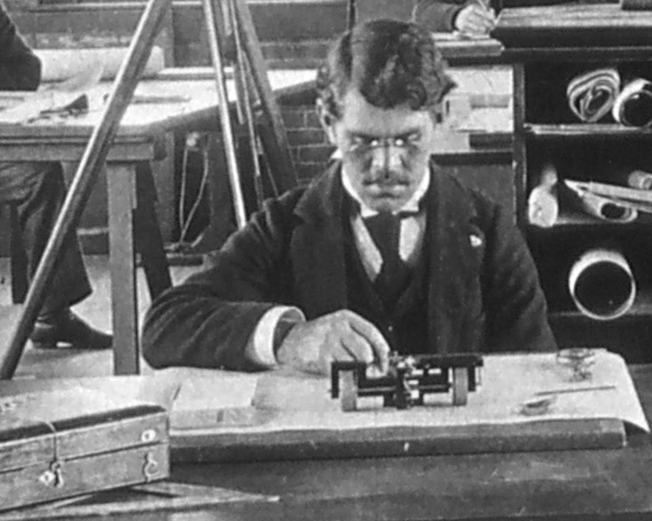
Day 2: Planimeters and Integrators.
The mechanical measurement of Areas, Moments of Inertia, and the like.
Thayer School's Rolling Sphere Planimeter ~ 1894
(Photograph from Dartmouth College Archives)

Slide 27
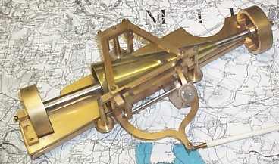


Area as the integral of rectangular increments
Two Early Attempts
x
y
Cone planimeter by Johann Martin Hermann, 1814.
Recorded increments of area have a magnitude proportional to y as we scan over x.
See website of Prof. Robert L. Foote, Wabash College, Crawfordsville, Indiana.
http://persweb.wabash.edu/facstaff/footer/Planimeter/PreAmsler.htm
Wetli-Starke Disc Planimeter, patented 1849.
http://www.history.didaktik.mathematik.uni-wuerzburg.de/ausstell/planimet/starke.html
Notes:
Screen area loop 2014.png; from Integrator Sketch 2013.md60

Slide 28



The Amsler Polar Planimeter of 1854
Hinge
Fixed Pole
Tracer
Sliding/Rolling
Measuring Dial
Measuring Arm
Two Innovations:
• Measuring with the sliding/rolling wheel.
• Hinged polar tracing geometry.
Jakob Amsler-Laffon
(1823 – 1912)
Swiss Mathematician and Industrialist
Inventor of the Polar Planimeter
Animation: http://persweb.wabash.edu/facstaff/footer/Planimeter/Polar&Linear.htm; by Prof. Robert Foote
J. Amsler Über die mechanische Bestimmung des Flächeninhaltes,..insbesondere über einen neuen Planimeter 1856
Figure from Keuffel & Esser catalog, 1908, shown in Wikipedia “Planimeter” (2017).
(Portrait: Wikipedia, “Jakob Amsler-Laffon”, 2017)
Notes:
Planimeter K&E catalog 1908.png; PolarAnimation.gif; Jakob_Amsler-Laffon.jpg

Slide 29

Rolling/Sliding Dial on a Linear Track
rolling
sliding
pivot
Allbrit Linear Rolling Planimeter
(Early 20th Century)
The rolling/sliding dial mechanism derives from Amsler's mechanism of 1854.
Because the large rollers proscribe a linear track, its operation is easy to explain.
(photograph courtesy of Douglas Fraser, 2017)
Notes:
photograph from Doug Fraser: DAF-20171026-Allbrit Rolling B.jpg

Slide 30


Wheel with Rolling & Sliding for the Recording Dial.
The moving measuring wheel rolls and slides as the pointer traces the perimeter of the shape to be measured.
Pointer
For linear geometry:
pivot point travels freely along the x axis.
Recording δx sinα is the same as recording (y/L) δx = ∆A/L
dial roller
roll
slide
Vernier scale
counter
Reading shown = 3.584
Notes:
Screen One Dial Operation; Screen single dial roller operation; both from Integrator Operation revived C

Slide 31

Operation of the Polar Planimeter
The rolling/sliding measurement system works for any shape of the track that the hinged pivoting end of the measuring arm must follow.
Decompose the area traversed by the measuring arm into
• area increments due to δφ.
• area increments due to δθ.
Distance measured by the roller:
(The δφ increments give no net contribution.)
Notes:
Screen Polar operation sketch 2018.png; from Polar operation sketch 2018.md60

Slide 32




Some Other Planimeter Designs
Linear:
Polar:
Coradi Rolling Disc Planimeter
K&E 4262, Catalog 36, 1921.
Coradi Polar Disc Planimeter
K&E 4251, Catalog 36, 1921.
Coradi Rolling Sphere Planimeter
K&E 4260, Catalog 36,1921.
The Willis Planimeter
from Carpenter & Diederichs, Experimental Engineering and Manual for Testing, Fig. 15
Notes:
S- K&E rolling disc 4262 36th ed. catalog.jpg; S- K&E rolling sphere 4260 36th ed. catalog.jpg

Slide 33

Radial Planimeters
To measure the average distance from the center (pole) on circular charts.
(sketch taken from the Keuffel & Esser catalog, 36th Edition, p. 252)
Notes:
Screen K&E radial planimeter – catalog.png; scanned from p. 252 of K&E catalog, 36th edition, .

Slide 34



Daily Chart for Pressure Difference Record
Flow Rate ∝ √(Pressure Difference) ⇒ Square-Root Planimeter Required
Center Post
Curve of the track, β(r), can be related to the functional relationship integrated by the planimeter dial.
Chart of pressure difference vs. time.
Principles and Practice of
Flow Meter Engineering
by L. K. Spink
The Foxboro Co., 6th Ed. 1947, p. 143
Following Tanya Leise,
As the Planimeter’s Wheel Turns; Planimeter Proofs for the Calculus Class, College Mathematics Journal, Jan. 2007
Notes:
Screen square-root planimeter from Leise.png; Screen tracer track function.png

Slide 35


American Meter Co. - Square Root Planimeter
(Photographs from eBay listing ended 11-4-2018)
Notes:
American Meter Co-Sq Root planimeter photo 2.jpg; American Meter Co-Sq Root planimeter photo 4.jpg

Slide 36
More Complex Integrals: Moments of Area
Area:
(Units: m²)
First Moment of Area:
(Units: m³)
(Used to get center of mass and also for calculating shear stresses in bending.)
(Used but not named in Hibbeler* Section 6.1)
Second Moment of Area:
;
(Units: m⁴)
("Moment of Inertia"; used in bending calculations. Hibbeler Eqn.(6-10).)
Third Moment of Area:
(Units: m⁵)
* Textbook: Statics and Mechanics of Materials, R.C. Hibbeler, Prentice Hall

Slide 37



Amsler Integrators
Amsler-Integrator Nr. 3
Amsler-Integrator Nr. 2
Images from the Amsler Catalog.
Amsler-Integrator Nr. 4
Notes:
Screen Amsler Integrator No.3 from Catalog.png; 6237940.fleaglass 2-dial.jpg

Slide 38




Amsler Integrators
Nr. 1 - Serial Nr. 904
Nr. 2 - Serial Nr. 1489
Nr. 3 - Serial Nr. 1071
Nr. 4 - Serial Nr. 865

Slide 39


Integrator
Operations
2-Dial Integrator
Allows for direct measurement of:
3-Dial Integrator
From planimeter A.
From dial I.
Notes:
Screen 2-dial integrator B.png; from Integrator Operation revived C.md60

Slide 40

Stability of Ships
Demand for Amsler Integrators ballooned in the early 1880’s when naval architects began to calculate the stability of the ships they were designing.
When a ship tilts over, the Center of Buoyancy (C of B) moves over creating a Restoring Moment that is proportional to the distance the C of B has moved,
which is the length of the Restoring Moment Arm.
Calculation of the restoring moment requires finding the center of gravity of the displaced volume –– a job for Amsler integrators.
Notes:
Screen Buoyancy restoring arm.png; from Buoyancy Sketch C.md60

Slide 41

Calculation of the Centroid Location
We need two separate calculations: one for x location and one for y location.
dA
or
(Hibbeler, Fig. 6-5)

Slide 42
Calculation of the Centroid Location
To get
To get
x
First Moment of Area:
(Hibbeler, Fig. 6-5)

Slide 43

To find the Center of an Arbitrary Shape by Integrating around the Perimeter.
• Find the Area: A (as with a planimeter).
• Find the first moment about the horizontal:
• Find the first moment about the vertical:
For Example, for Q_{x} :

Slide 44

Sketch of Integrator Use.
Profiles of the stern
Profiles of the Bow
A Treatise on the Stability of Ships, by Sir Edward J. Reed, K.C.B., F.R.S., M.P., 1885

Slide 45


Determination of Curves of Stability
Calculation of Restoring Moment Arm is repeated for different angles of heel and different water levels.
Moment
Arm
(J.H. Biles, The Design and Construction of Ships,
2nd Edition, 1923, Part IV. Stability, Chapter 5)

Slide 46


Related Instruments that were not covered.
Coradi Integraph
1915 Catalog
Draws the integral of a curve as it is traced.
Stanley
Harmonic Analyzer
Gives the Fourier components of an
arbitrary function.
(Image from the working instructions for the Harmonic Analyser by Stanley)

Slide 47
Day 2 Conclusions:
• The operation of the basic planimeter is easy to learn.
• The math is not overwhelming, but takes time to absorb.
• The explanation of the square-root planimeter is as difficult to absorb, and time consuming, as that for the basic polar planimeter.
• The hands-on project of calibrating an advanced planimeter was engaging.
• In one morning it was difficult to get past planimeters to cover integrators.

Slide 48


Day 3: Mechanical Calculations
Beginning with the Abacus:
Smithsonian, National Museum of American History
https://ids.si.edu/ids/deliveryService?id=NMAH-84-14632
There is, of course, a website with a Virtual Abacus:
http://www.alcula.com/soroban.php

Slide 49

Napier’s Bones
Invented 1617
Basically a multiplication table written on separate, movable columns.
photograph shown on:
https://www.rainbowresource.com/product/0516536/Napiers-Bones-Set.html

Slide 50





Multiplication with Napier’s Rods
Notes:
Screen 427658 x 649.png; Screen numerals for 427658 x 649.png; Screen bones for 427658 x 649.png

Slide 51
Genaille-Lucas Rulers
For Multiplication
Start with top digit in the far right column.
427,658
× 6
2,565,948
Follow triangles to the left.
Invented 1891 by Henri Genaille, a French railway engineer, in response to a problem posed by mathematician Édouard Lucas.
Wikipedia, 2018,
“Genaille-Lucas rulers”,
Author: Worrydream.
Notes:
Screen 427658 x 6.png; Screen Index Column(.png); Screen Column 4(.png); Screen Column 2(.png); etc.

Slide 52








Genaille-Lucas Division Rulers
427,658
6 ) 2,565,948
Start with top digit in the far left column.
Follow the lines to the right.
Final digit in the “R” column is the remainder.
Wikipedia, 2018,
“Genaille-Lucas rulers”,
Author: Staecker.
Notes:
Sc 2565948 by 6(.png); Sc division column Index(.png); Sc division column 2(.png); ......... Sc division column remainder(.png)

Slide 53


Troncet Type Adding Machines
History of Computers and Computing, Calculating Tools, Gadgets, Troncet
https://history-computer.com/CalculatingTools/Gadgets/Troncet.html
Wikipedia, 2019, Mechanical calculator, photograph by Adrignola.

Slide 54



Early Elaborate Adding Machines
Blaise Pascal’s machine (1652)
Musée des Arts et Métiers
(Wikipedia 2020, photograph by Rama)
Phillip Hahn’s machine (1770’s)
(made by Johann Christoph Schuster)
https://history-computer.com/MechanicalCalculators/18thCentury/Hahn.html
Leibnitz Stepped Reckoner ~1697 (replica)
Technische Sammlungen museum in Dresden
(Wikipedia 2020, photograph by Kolossos)

Slide 55



Arithmometer
The first mass-produced mechanical calculator.
(Introduced 1821, commercialized from 1852.)
An Arithmometer built around 1863.
Based on the Leibniz rotating ribbed cylinder.
Charles-Xavier Thomas de Colmar
(1785 – 1870)
French Inventor and Entrepreneur.
Portrait from: https://history-computer.com/
MechanicalCalculators/19Century.html
(Wikipedia (2020) Arithmometer; Author: Ezrdr)

Slide 56



Other Adding Machines
The Millionaire (produced 1893-1935),
Designed by Swiss Engineer Otto Steiger.
Multiplies (by one digit) with one turn of the crank.
(Photo: ebay auction, oughtred11, ending 8/23/20)
Lever to set the number of pins extended.
pins
Odhner’s Pinwheel Calculator
Wikipedia, Photo by Erzdr
The pin-wheel mechanism.
Notes:
s-l1600 Millionaire ebay.jpg; in folder Millionaire Otnes on eBay 2020 folder

Slide 57


Key Driven Adding Machines
Burrough’s Adding Machine
An early Comptometer (1887)
First commercially successful key-driven calculating machine.
The Victor Adding Machine
Smithsonian, catalog number 1982.0475.01
(Wikipedia, 2018, Comptometer, photo: Ezrdr)
Notes:
Screen Dorr Felt.jpg; 315px-EarlyComptometerMachine.png

Slide 58

Office with 15 Comptometers (1947).
(Operated by 15 Computers)
From the website Early Office Museum, Antique Adding and Calculating Machines,
Key Driven Calculating Machines, "From the Studios of Felt & Tarrant Mfg. Co., Chicago"
(http://www.officemuseum.com/1947_Office_with_15_Comptometers.jpg)
Notes:
1947_Office_with_15_Comptometers.jpg

Slide 59


CURTA Calculator
Curt Herzstark
(1902 – 1988)
Austrian Engineer
Inventor of the Curta pocket calculator
Type I
(Photographs from http://www.vcalc.net/cu.htm)
Notes:
Curt-1970x-Herzstark-portrait-222x306.png

Slide 60


Charles Babbage
Difference Engine (from 1822)
and
Analytical Engine (from 1837)
(1791 – 1871)
English Polymath
Lucasian Professor of Mathematics
in the University of Cambridge
(Wikipedia, 2020, portrait (1833) by M. Salmon)
Notes:
Difference_engine_plate_1853.jpg

Slide 61

Oughtred Society newsletter, October, 2015

Slide 62


Difference Engine by Georg Scheutz
Built in 1853, based on the Babbage design;
Handled 15 digits, with 4th order differences.
Displayed at Paris World’s Fair of 1855;
Fitted with a printer.
Sold to Dudley Observatory, NY in 1856.
Another was built for the British Govt., 1859.
Pers Georg Scheutz
(1785 – 1873)
Swedish Lawyer, Translator, and Inventor
(actually put to use)
(Figures from Wikipedia, “George Scheutz”, 2019)
Notes:
Scheutz_mechanical_calculator.png; Georg_Scheutz.jpg

Slide 63
Day 3 Conclusions
• Students were amused by the simple devices:
Napier’s Bones, Genaille-Lucas Rulers, Troncet adders.
• Appreciation of the mechanisms of advanced adding machines requires more extensive explanations, and probably the direct observation of disassembled machines.
• Stories of Curt Herzstark and Charles Babbage should be presented through prior assigned readings.
• Using a key-driven adding machine is not as engaging as calibrating a planimeter or integrator.

Slide 64


Day 4: Nomography and Graphical Calculation
Nomogram, n.: from Greek:
νομοσ, “law” + γραμμη, “line”
(oed.com, 2018)
p (psia)
T (°F)
H
(Btu/lb)
Enthalpy of Steam
H = f(p,T)
Philbert Maurice d’Ocagne
(1862-1938)
French Engineer and Mathematician,
Founder of Nomography.
(V. Ganapathy, Nomograms for Steam Generation and Utilization, 1985, p. 29)
(Photo from Wikipedia, 2019)
Notes:
Screen Ganapathy steam H-p-T.png

Slide 65


Simple Parallel Nomogram
Or anything that can be manipulated into Σ (three items) = 0.
A + B = C
A × B = C

Slide 66

Four-variable Nomogram
q
S
R
V
C
Flow of water in a channel:
V = velocity.
S = slope.
R = hydraulic radius.
C = coefficient.
Given any three values,
the fourth can be determined.
Joseph Lipka, 1918, Fig. 29b, p. 58,
Graphical and Mechanical Computation,
Notes:
Screen 4 variable V = C rt(RS).png

Slide 67

Nomogram for 5 Variables.
Power of a Piston Engine:
P = Pressure; L = Stroke; D = Diameter; N = Speed (rpm)
P
L
D & L use the same scale.
N
D
(H.P.)
P × L
D² × N
Joseph Lipka, 1918, Graphical and Mechanical Computation, Fig. 31b, p. 63
Notes:
Sc Five variable nomgram.jpg; from Sc Five variable nomgram.png; from Five variable nomogram.jpg

Slide 68

Quadratic Equation Solver
(A specialized nomogram)
Example shown:
p = -1
q = -6
x = 3, -2
or in normalized form:
(Wikipedia, 2019, “Nomogram”; Author: Szalkailstvan.)
Notes:
Screen quadratic nomogram from macdraft.png; from quadratic in macdraft.md60

Slide 69

Cubic Equation Solver
(Showing only the real roots.)
z = -1.1
q
z = -0.8
Transforms to:
with
;
p
Region of 3 real roots
A fixed value of z gives a straight line relationship between p and q.
Region of 1 real root and 2 imaginary roots
Given (a,b,c,d), calculate (p,q) and plot, then find z by interpolation between the lines.
Joseph Lipka, 1918, Graphical and Mechanical Computation, Fig. 19, p. 36
Notes:
Screen Cubic eqn. soln. chart.png; Cubic equation solution chart.jpg

Slide 70

Special Papers
Plotting on graph paper with the right scale can reveal functionality.
(Wikipedia, 2020, Logarithmic Scale; Author: Soaring)

Slide 71



Normal Probability Paper.
Test
Result
Test Ranking
Fifty Random Points
from a normal distribution
μ = 5
σ = 1
Test Number
Test Result
Theoretical
Quantiles
Test Result
Notes:
Screen 50 random tests.png; Screen 50 test cumulative.png

Slide 72
Normal Probability Paper

Slide 73




Examples of Special Charts
Enthalpy (kJ/kg)
Smith Charts
Electrical Impedance and Reflectance.
Entropy kJ/(kg·K)
Thermodynamic Charts
p-v, T-s, Mollier diagrams (h-s).
Wulff Nets and Greninger Charts
Crystal orientation and X-ray diffraction.

Slide 74
Day 4 Conclusions
• Nomograms are easy to understand and use.
• Treatment of probability paper (normal/Weibell) needs more work.
The topic should be common to all our students.
• Specialized charts are difficult to explain in a limited time.
They generally require more advanced study in a particular discipline.
• We need to develop a better hands-on project for the day.

Slide 75
Overall Conclusions
• No exams & no written assignments ⇒ Learning hard to evaluate.
• Students seemed comfortable with the required calculus.
• Students were not very facile with basic arithmetic.
• Students enjoyed most the hands-on experience with instruments.
• Planimeters and Integrators should be given separate days.
• Unlikely to work as a remote learning activity
⇒ Pandemic means the 2020 offering remains uncertain.
• Topic is ripe for expansion into a full term course on the
history of technology.
Thanks.
Corrections and Suggestions to:
harold.j.frost@dartmouth.edu

